Slide 1

SQL for Film Analytics: From Queries to Insights
Project by Yelyzaveta Ben

Slide 2
Project overview
This project aims to use SQL to analyze and optimize film-related data, offering actionable insights to drive business decisions and enhance efficiency in the film industry. The project will use SQL to identify trends in film rentals, sales, and payments, pinpointing the most profitable films and peak rental times. Insights from this analysis will inform pricing strategies and promotional activities, maximizing revenue.
SQL will help segment customers based on their rental patterns and spending. This segmentation enables the development of targeted marketing campaigns and personalized recommendations, enhancing customer satisfaction and loyalty. By analyzing film inventory and rental data, SQL will support effective stock management. The goal is to ensure popular films are available while optimizing inventory turnover and reducing underperforming stock.

Slide 3
Dataset
actor
actor_id
first_name
last_name
category
category_id
name
city
city_id
city
country_i
country
country_id
country
customer
customer_id
store_id
first_name
last_name
email
create_date
active
film
film_id
title
description
release_year
language_id
rental_duration
rental_rate
length
replacement_cost
rating
payment
payment_id
customer_id
staff_id
rental_id
amount
payment_date
inventory
inventory_id
film_id
store_id

Slide 4
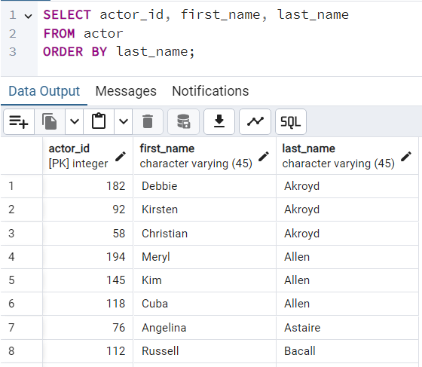
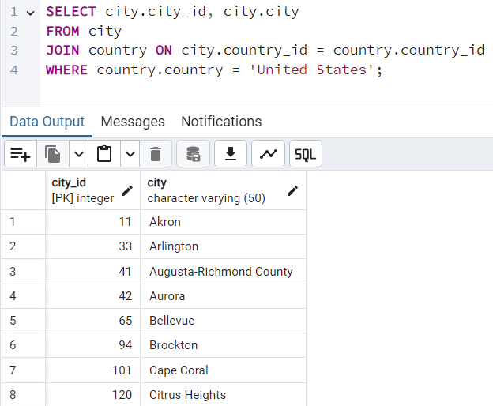
Task 1.1 List all actors in the database, sorted by their last name
Task 1.2 Find all cities in the country with the name "United States"

Slide 5
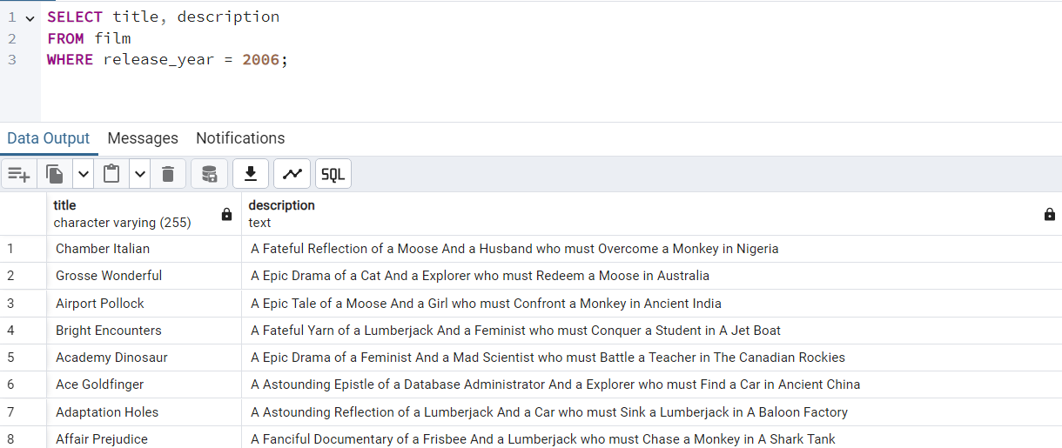
Task 1.3 Retrieve the title and description of all films released in the year 2006

Slide 6
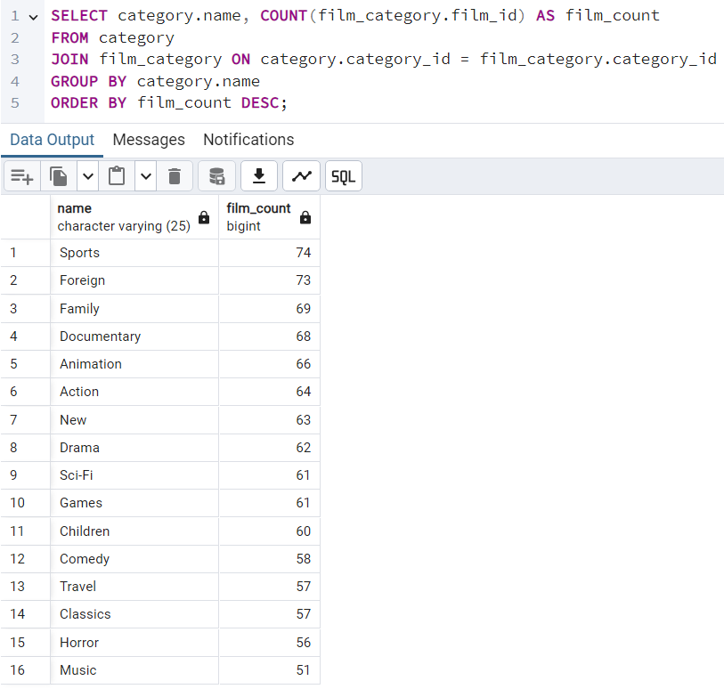
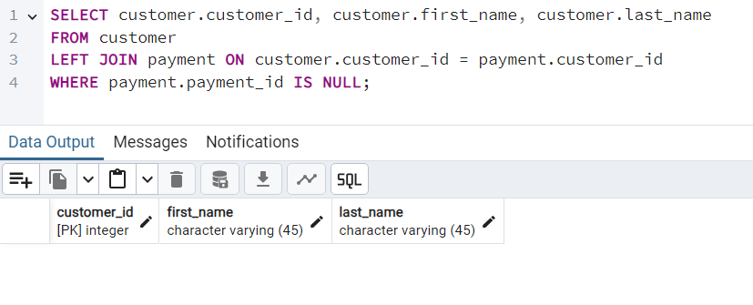
Task 2.1: Find the number of films in each category
Task 2.2: List all customers who have never made a payment.
It seems like we do not have customers who have never made in our database

Slide 7
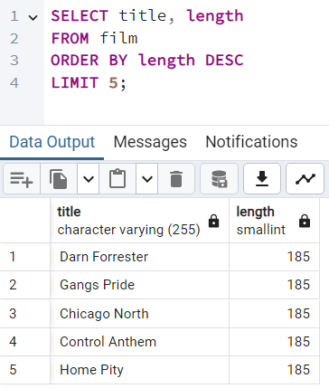
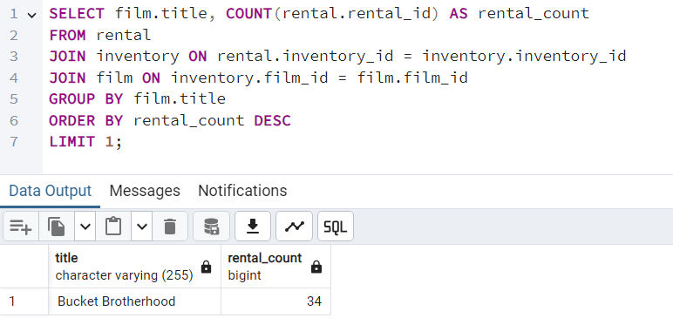
Task 2.3: Find the top 5 longest films and their durations.
Task 3.1: Find the most rented film

Slide 8
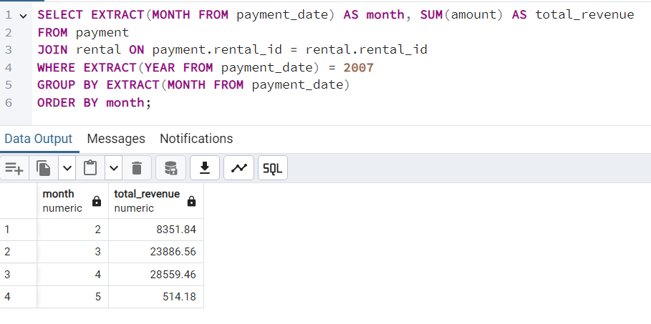
Task 3.2: Calculate the total revenue generated from film rentals in each month of 2007

Slide 9
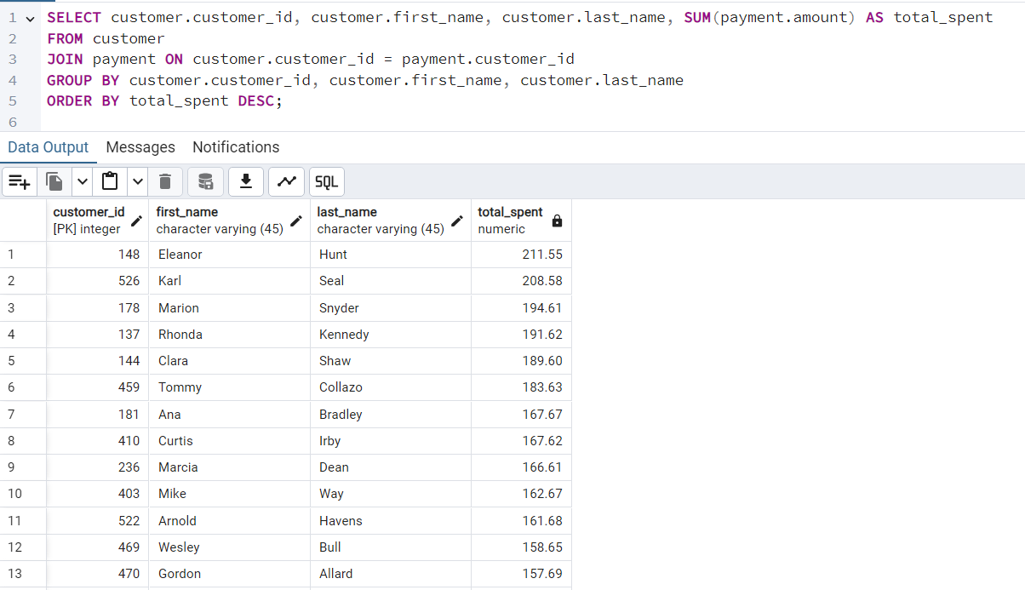
Task 3.3: List all customers along with the total amount they have spent

Slide 10
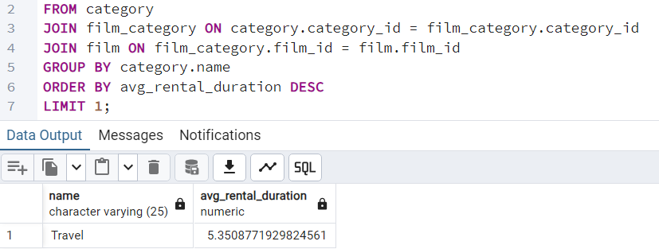
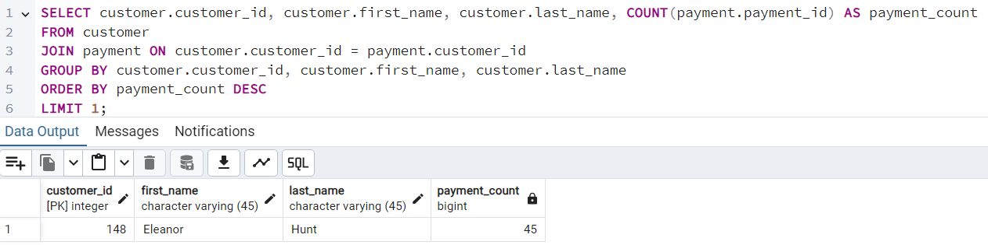
Task 4.1: Find the film category with the highest average rental duration
Task 4.2: Retrieve the details of the most active customer (based on the number of payments made)

Slide 11

Results
Revenue Insights:
The project revealed significant variations in monthly revenue, identifying peak periods for film rentals in 2007. This information is crucial for optimizing pricing strategies and promotional campaigns to maximize profits during high-demand periods.
Customer Segmentation:
By analyzing customer data, the project identified distinct segments based on rental frequency and spending patterns. This segmentation allows for the development of personalized marketing strategies, enhancing customer engagement and loyalty.
Inventory Management:
The analysis highlighted the most and least popular films, guiding inventory decisions to ensure that in-demand titles are readily available while reducing the stock of underperforming films. This approach optimizes inventory turnover and reduces holding costs.
Business Reporting:
Detailed reports and visualizations were generated, offering a comprehensive view of the business's financial and operational metrics. These reports provide stakeholders with a clear understanding of the business's performance, aiding in strategic planning and resource allocation.
Strategic Planning:
The insights gained from the data analysis support long-term strategic initiatives such as market expansion and film acquisition. By identifying emerging trends and customer preferences, the business can make informed decisions that align with future growth opportunities.

